Slide 1
STUDENT NAME – Lithikhaa K REGISTER NO – 711721243054 DEPARTMENT – B.Tech Artificial Intelligence and Data Science
Rice Classification using CNN
3/21/2024 Annual Review

Slide 2
PROJECT TITLE : Rice Classification using CNN
3/21/2024 Annual Review

Slide 3


AGENDA
Problem Statement
Project Overview
End Users
Our solution and Proposition
Key Features
Modelling Approach
Results and Evaluation
Conclusion
3/21/2024 Annual Review

Slide 4

PROBLEM STATEMENT
Manual sorting errors lead to inconsistent rice quality, impacting producers, distributors, and consumers negatively.
Inefficient classification causes financial losses, undervaluing premium rice and rejecting lower-grade ones.
Accurate rice classification minimizes waste promoting sustainability by optimizing rice utilization across grades.
3/21/2024 Annual Review

Slide 5
PROJECT OVERVIEW
The Rice Classification System aims to develop an efficient and accurate automated system for classifying rice based on various quality parameters.
This system addresses the need for consistent quality assurance, meeting market demands, and ensuring economic viability in the rice industry.
Detects contaminants and impurities in rice, mitigating health risks for consumers.
Streamlines rice processing, ensuring timely delivery to consumers.
3/21/2024 Annual Review

Slide 6

WHO ARE THE END USERS?
Agricultural researchers and scientists
Farmers and agricultural workers
Food processing companies
Agricultural technology companies
Government agencies and policymakers
3/21/2024 Annual Review

Slide 7

YOUR SOLUTION AND ITS VALUE PROPOSITION
We proposed a solution in CNN Architecture trained on a dataset of labeled images containing with different variety of rice
Automated image analysis with Accurate rice variety classification and quality assessment.
Enhances agricultural processes, drives advancements in computer vision.
Improves efficiency, seed selection, ensures rice product quality.
3/21/2024 Annual Review

Slide 8

THE WOW IN YOUR SOLUTION
Automated image analysis revolutionizes rice classification.
Precision and speed ,Instantaneous, accurate assessment of rice variety quality.
Empowers stakeholders from farmers to policymakers, enhancing decision-making.
Enhancing food security and sustainability with technology.
3/21/2024 Annual Review
8

Slide 9
MODELLING
Convolutional Neural Networks (CNNs) for Rice Classification:
CNNs are ideal for image classification tasks like rice classification due to their ability to automatically learn and extract hierarchical features from images.
Data Preprocessing for Rice Classification:
Image Loading: Load the rice grain images from the dataset, ensuring that they are properly labeled with their corresponding rice type.
Resizing: Resize the images to a standard size (e.g., 224x224 pixels) suitable for CNN input while maintaining the aspect ratio.
Normalization: Normalize the pixel values of the images to a range between 0 and 1 to ensure uniformity and facilitate training convergence
Training Process for Rice Classification:
Model Architecture Selection: Choose a CNN architecture suitable for image classification tasks, such as ResNet, Inception, or EfficientNet.
Training: Train the CNN model on the training dataset using techniques like mini-batch stochastic gradient descent (SGD) or Adam optimizer.
Validation: Validate the model's performance on the validation set to monitor for overfitting.
3/21/2024 Annual Review
9

Slide 10
MODELLING
Fine-Tuning for Rice Classification:
Freezing Layers: Freeze the weights of the initial layers of the pre-trained CNN to preserve the learned features.
Unfreezing Top Layers: Unfreeze the top layers of the CNN to allow them to adapt to the rice classification task by updating their weights during training.
Fine-Tuning: Fine-tune the model on the rice dataset using a lower learning rate compared to the initial training to prevent drastic changes to the pre-learned features.
Model Evaluation for Rice Classification:
Accuracy: Compute the classification accuracy of the trained model on the test set to measure its overall performance.
Precision, Recall, F1-Score: Calculate precision, recall, and F1-score for each class to assess the model's performance on individual rice types.
Confusion Matrix: Generate a confusion matrix to visualize the model's performance in terms of true positive, false positive, true negative, and false negative predictions for each class.
3/21/2024 Annual Review
10

Slide 11
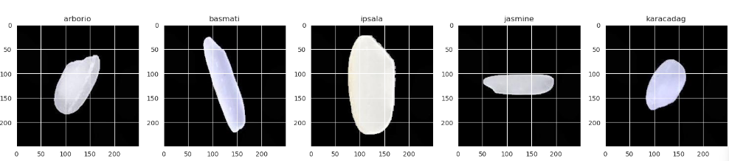
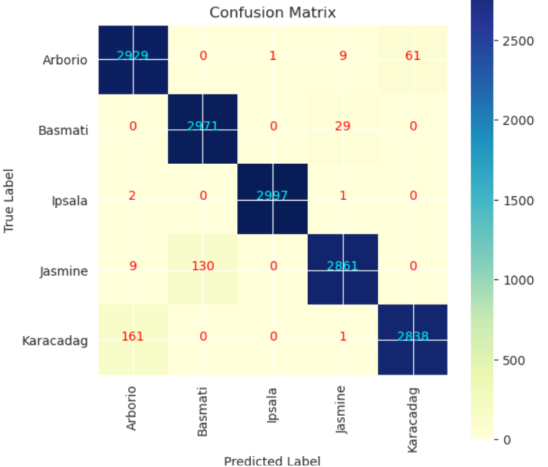
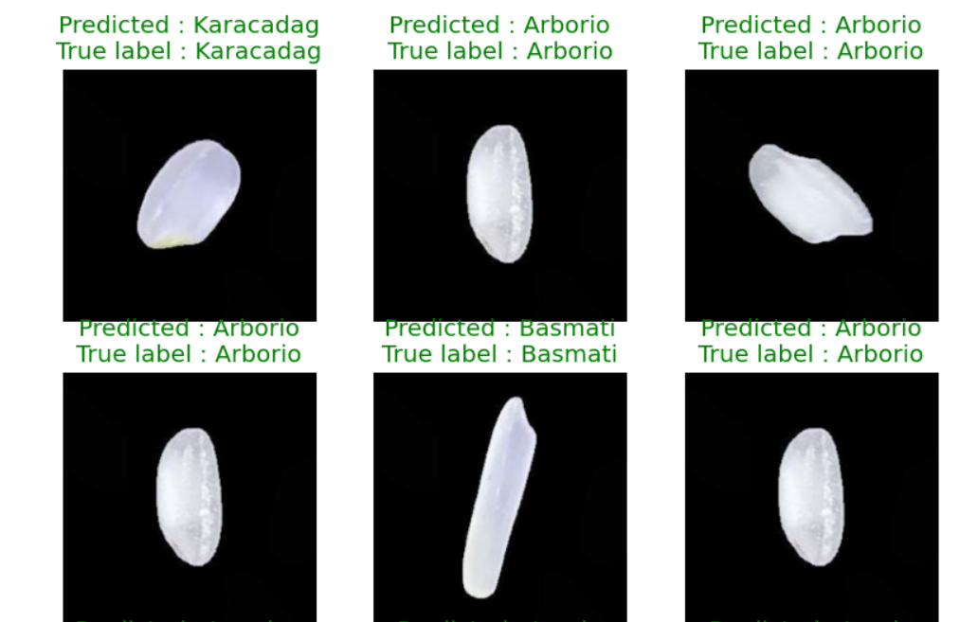
RESULTS
3/21/2024 Annual Review
11

